Slide 1
Lex – A tool for lexical analysis

Slide 2
Lexical and syntactic analysis
Input
Stream
Lexical
Analyzer
Stream of
Tokens
Syntactic analyzer
(parser)
Parse
tree
Lexical analyzer: scans the input stream and converts sequences of characters into tokens.
(char list) → (token list)
Lex is a tool for writing lexical analyzers.
Syntactic Analysis: reads tokens and assembles them into language constructs using the grammar rules of the language.
Yacc is a tool for constructing parsers.

Slide 3
Lexical Analysis
What do we want to do? Example:
if (i == j)
z = 0;
else
z = 1;
The input is just a sequence of characters:
if (i == j)\n\tz = 0;\nelse\n\tz = 1;
Goal: Partition input strings into substrings
And classify them according to their role
Slide credit: Wes Weimer

Slide 4
Tokens
Output of lexical analysis is a list of tokens
A token is a syntactic category
In English:
noun, verb, adjective, ...
In a programming language:
Identifier, Integer, Keyword, Whitespace, ...
Parser relies on token distinctions:
e.g., identifiers are treated differently than keywords
Slide credit: Wes Weimer

Slide 5
Example
Recall:
if (i == j)\n\tz = 0;\nelse\n\tz = 1;
Token-lexeme pairs returned by the lexer:
<Keyword, “if”>
<Whitespace, “ ”>
<OpenPar, “(”>
<Identifier, “i”>
<Whitespace, “ ”>
<Relation, “==”>
<Whitespace, “ ”>
...
Slide credit: Wes Weimer

Slide 6
Implementation of A Lexical Analyzer
The lexer usually discards uninteresting tokens that don't contribute to parsing.
Examples: Whitespaces, Comments
Exception: which language cares about whitespaces?
The goal is to partition the string. That is implemented by reading left-to-right, recognizing one token at a time.
Lexical structure described can be specified using regular expressions.
Slide credit: Wes Weimer

Slide 7
Regular Expressions
In computing, a regular expression, also referred to as "regex" or "regexp", provides a concise and flexible means for matching strings of text, such as particular characters, words, or patterns of characters. A regular expression is written in a formal language that can be interpreted by a regular expression processor.
http://en.wikipedia.org/wiki/Regular_expression

Slide 8
Regular Expressions
Regular expressions are used in many programming languages and software tools to specify patterns and match strings.
Regular expressions are well suited for matching lexemes in programming languages.
Regular expressions use a finite alphabet of symbols and defined by the operators
(i) union
(ii) concatenation
(iii) Kleene closure.
Slide credit: Wes Weimer

Slide 9
Regular Expressions
Unix programs like egrep, awk, and lex extend this simple notation with additional operators and shorthands.
Perl has amazingly rich regular expressions which further extend the egrep, awk, and lex regular expressions.
Perl compatible regular expressions have been adopted by Java, JavaScript, PHP, Python, and Ruby.
Slide credit: Wes Weimer

Slide 10


Slide 11
Introduction
Lex:
reads in a collection of regular expressions, and uses it to write a C or C++ program that will perform lexical analysis. This program is almost always faster than one you can write by hand.
Yacc:
reads in the output from lex and parses it using its own set of regular expression rules. This is almost always slower than a handwritten parser, but much faster to implement. Yacc stands for “Yet Another Compiler Compiler”.

Slide 12
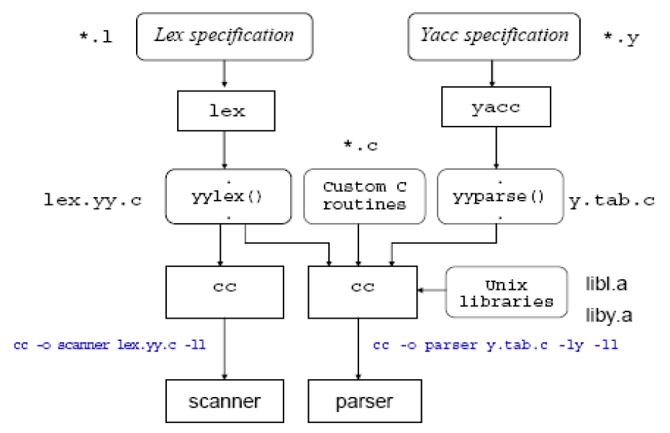
Using lex and yacc tools

Slide 13
Running lex
On Unix system
$ lex mylex.l
it will create lex.yy.c
then type
$ gcc -o mylex lex.yy.c -lfl
The open-source version of lex is called “flex”

Slide 14
Using lex
Contents of a lex program:
Declarations
%%
Translation rules
%%
Auxiliary functions
The declarations section can contain declarations of variables, manifest constants, and regular definitions. The declarations section can be empty.
The translation rules are each of the form
pattern {action}
Each pattern is a regular expression which may use regular definitions defined in the declarations section.
Each action is a fragment of C-code.
The auxiliary functions section starting with the second %% is optional. Everything in this section is copied directly to the file lex.yy.c and can be used in the actions of the translation rules.

Slide 15
Simple lex program (ex0.l)
ex0.l : (edit with emacs, vi, etc.)
%%
.|\n ECHO;
%%
($ is the unix prompt)
$lex ex0.l
$gcc -o ex0 lex.yy.c –lfl
$ls
ex0 ex0.l lex.yy.c

Slide 16
Simple lex program (ex0.l)
$vi test0
$cat test0
ali
Veli
$ cat test0 | ex0 (or $ex0 < test0)
ali
Veli
Simply echos the input file contents

Slide 17
Example lex program (ex1.l)
Ex1.l :
%%
zippy printf(“I RECOGNIZED ZIPPY”);
$cat test1
zippy
ali zip
veli and zippy here
zipzippy
ZIP
$cat test1 | ex1
I RECOGNIZED ZIPPY
ali zip
veli and I RECOGNIZED ZIPPY here
zipI RECOGNIZED ZIPPY
ZIP

Slide 18
Example lex program (ex2.l)
%%
zip printf(“ZIP”);
zippy printf(“ZIPPY”);
$cat test1 | ex2
ZIPPY
ali ZIP
veli and ZIPPY here
ZIPZIPPY
lex matches the input string the longest regular expression possible!

Slide 19
Example lex program (ex3.l)
%%
monday|tuesday|wednesday|thursday|friday|
saturday|sunday printf("<%s is a day.>", yytext);
$cat test3
today is wednesday september 27
$ex3 < test3
today is <wednesday is a day> september 27
Lex declares an external variable called yytext which contains the matched string

Slide 20
Designing patterns
Designing the proper patterns in lex can be very tricky, but you are provided with a broad range of options for your regular expressions.
. A dot will match any single character except a newline.
*,+ Star and plus used to match zero/one or more of the preceding expressions.
? Matches zero or one copy of the preceding expression.

Slide 21
Designing patterns
| A logical ‘or’ statement - matches either the pattern before it, or the pattern after.
^ Matches the very beginning of a line.
$ Matches the end of a line.
/ Matches the preceding regular expression, but only if followed by the subsequent expression.

Slide 22
Designing patterns
[ ] Brackets are used to denote a character class, which matches any single character within the brackets. If the first character is a ‘^’, this negates the brackets causing them to match any character except those listed. The ‘-’ can be used in a set of brackets to denote a range.
“ ” Match everything within the quotes literally - don’t use any special meanings for characters.
( ) Group everything in the parentheses as a single unit for the rest of the expression.

Slide 23
Regular expressions in lex
• a matches a
• abc matches abc
• [abc] matches a, b or c
• [a-f] matches a, b, c, d, e, or f
• [0-9] matches any digit
• X+ matches one or more of X
• X* matches zero or more of X
• [0-9]+ matches any integer
• (…) grouping an expression into a single unit
• | alternation (or)
• (a|b|c)* is equivalent to [a-c]*

Slide 24
Regular expressions in lex
X? X is optional (0 or 1 occurrence)
if(def)? matches if or ifdef (equivalent to if|ifdef)
[A-Za-z] matches any alphabetical character
. matches any character except newline character
\. matches the . character
\n matches the newline character
\t matches the tab character
\\ matches the \ character
[ \t] matches either a space or tab character
[^a-d] matches any character other than a,b,c and d

Slide 25
Examples
Real numbers, e.g., 0, 27, 2.10, .17
[0-9]*(\.)?[0-9]+
To include an optional preceding sign:
[+-]?[0-9]*(\.)?[0-9]+
Integer or floating point number
[0-9]+(\.[0-9]+)?
Integer, floating point, or scientific notation.
[+-]?[0-9]+(\.[0-9]+)?([eE][+-]?[0-9]+)?

Slide 26
A slightly more complex program (ex4.l)
%%
[\t ]+ ;
monday|tuesday|wednesday|thursday|friday| saturday|sunday printf("%s is a day.",yytext);
[a-zA-Z]+ printf("<%s is not a day.>",yytext);

Slide 27
ex5.l
%%
[\t ]+ ;
Monday|Tuesday|Wednesday|Thursday|Friday
printf("%s is a week day.",yytext);
Saturday|Sunday
printf("%s is a weekend.",yytext);
[a-zA-Z]+
printf("%s is not day.",yytext);

Slide 28
Structure of a lex program
Declarations
%%
Translation rules
%%
Auxiliary functions
The declarations section can contain declarations of variables, manifest constants, and regular definitions. The declarations section can be empty.
The translation rules are each of the form
pattern {action}
Each pattern is a regular expression which may use regular definitions defined in the declarations section.
Each action is a fragment of C-code.
The auxiliary functions section starting with the second %% is optional. Everything in this section is copied directly to the file lex.yy.c and can be used in the actions of the translation rules.
28

Slide 29
Declarations
%%
[+-]?[0-9]*(\.)?[0-9]+ printf("FLOAT");
The same lex specification can be written as:
digit [0-9]
%%
[+-]?{digit}*(\.)?{digit}+ printf("FLOAT");
input: ab7.3c--5.4.3+d++5
output: abFLOATc-FLOATFLOAT+d+FLOAT

Slide 30
Declarations
digit [0-9]
sign [+-]
%%
float val;
{sign}?{digit}*(\.)?{digit}+ {sscanf(yytext, "%f", &val);
printf(">%f<", val);
}
Input => Output
ali-7.8veli => ali>-7.800000<veli
ali--07.8veli => ali->-7.800000<veli
+3.7.5 => >3.700000<>0.500000<

Slide 31
Declarations
/* echo-uppercase-words.l */
%%
[A-Z]+[ \t\n\.\,] printf("%s",yytext);
. ; /* no action specified */
The scanner for the specification above echo all strings of capital letters, followed by a space tab (\t) or newline (\n) dot (\.) or comma (\,) to stdout, and all other characters will be ignored.
Input Output
Ali VELI A7, X. 12 VELI X.
HAMI BEY a HAMI BEY

Slide 32
Declarations
Declarations can be used in Declarations
/* def-in-def.l */
alphabetic [A-Za-z]
digit [0-9]
alphanumeric ({alphabetic}|{digit})
%%
{alphabetic}{alphanumeric}* printf("Variable");
\, printf("Comma");
\{ printf("Left brace");
\:\= printf("Assignment");

Slide 33
Lex file structure
Definitions
%%
Regular expressions and associated actions (rules)
%%
User routines
Important Note: Do not leave extra spaces and/or empty lines at the end of the lex specification file.

Slide 34
Auxiliary functions
The user sub-routines section is for any additional C or C++ code that you want to include. The only required line is:
main() { yylex(); }
This is the main function for the resulting program.
Lex builds the yylex() function that is called, and will do all of the work for you.
Other functions here can be called from the rules section

Slide 35
Rule order
If more than one regular expression match the same string the one that is defined earlier is used.
/* rule-order.l */
%%
for printf("FOR");
[a-z]+ printf("IDENTIFIER");
for input
for count := 1 to 10
the output would be
FOR IDENTIFIER := 1 IDENTIFIER 10

Slide 36
Rule order
However, if we swap the two lines in the specification file:
%%
[a-z]+ printf("IDENTIFIER");
for printf("FOR");
for the same input
the output would be
IDENTIFIER IDENTIFIER := 1 IDENTIFIER 10

Slide 37
Example Number Identifications (ex6.l)
%%
[\t ]+ /* Ignore Whitespace */;
[+-]?[0-9]+(\.[0-9]+)?([eE][+-]?[0-9]+)?
printf(" %s:number", yytext);
[a-zA-Z]+
printf(" %s:NOT number", yytext);
%%
main() { yylex(); }

Slide 38
More patterns
What about literal strings?
Does this work? \".*\"
What about: \"[^\"]*\"
We need to use: \"[^\"\n]*\"

Slide 39
Counting Words (ex7.l)
%{
int char_count = 0;
int word_count = 0;
int line_count = 0;
%}
word [^ \t\n]+
eol \n
%%
{word} {word_count++; char_count+=yyleng;}
{eol} {char_count++; line_count++;}
. char_count++;
%%
main() {
yylex();
printf("line_count = %d , word_count = %d,
char_count = %d\n", line_count, word_
count, char_count);
}
lex also provides a count yyleng of the number of characters matched

Slide 40
Counting words (cont’d.)
$ cat test8
how many words
and how many lines
are there
in this file
$ex7 < test8
line_count = 5, word_count = 12,char_count = 58
Notes:
$ex7 olacak sonucu kontrol et

Slide 41
ex8.l
%%
int k;
-?[0-9]+ {
k = atoi(yytext);
printf("%d", k%7 == 0 ? k+3 :k+1);
}
-?[0-9\.]+ ECHO;
[A-Za-z][A-Za-z0-9]+ printf(“<%s>",yytext);
%%

Slide 42
ex9.l
%{
int lengs[100];
%}
%%
[a-z]+ {lengs[yyleng]++ ;
if(yyleng==1) printf(“<%s> ", yytext); }
. |
\n ;
%%
yywrap()
{
int i;
printf("Lenght No. words\n");
for(i=0; i<100; i++) if(lengs[i] >0)
printf("%5d%10d\n", i, lengs[i]);
return(1) ;
}
yywrap is called whenever lex reaches an end-of-file
Notes:
%{ %} eklenecek

Slide 43
romans.l
WS [ \t]+
%%
int total=0;
I total += 1;
IV total += 4;
V total += 5;
IX total += 9;
X total += 10;
XL total += 40;
L total += 50;
XC total += 90;
C total += 100;
CD total += 400;
D total += 500;
CM total += 900;
M total += 1000;
{WS} |
\n return total;
%%
int main (void) {
int first, second;
first = yylex ();
second = yylex ();
printf ("%d + %d = %d\n", first, second, first+second);
return 0;
}

